Slide 1
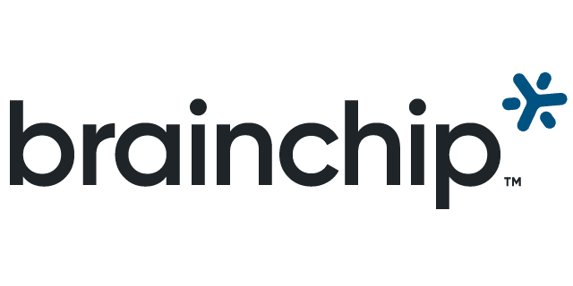
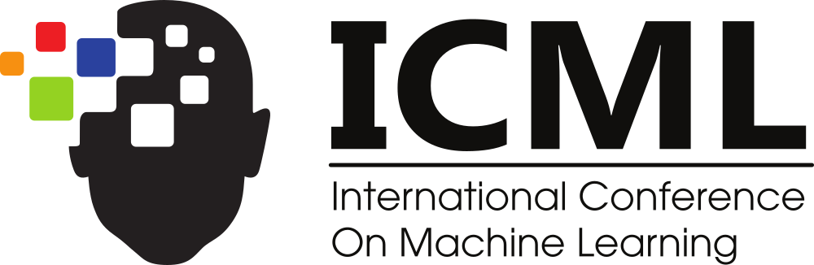
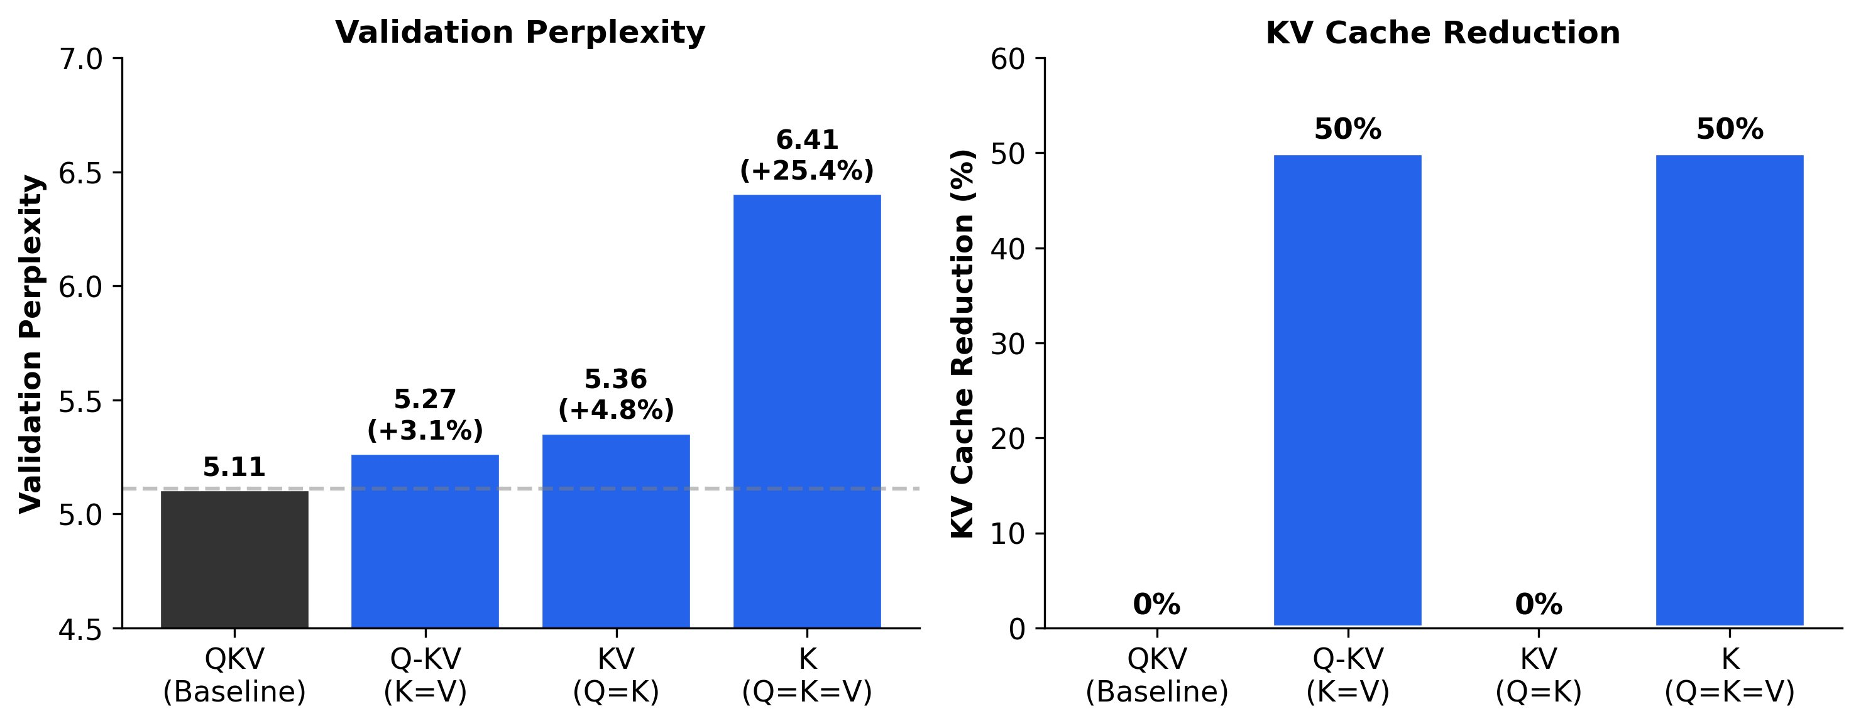
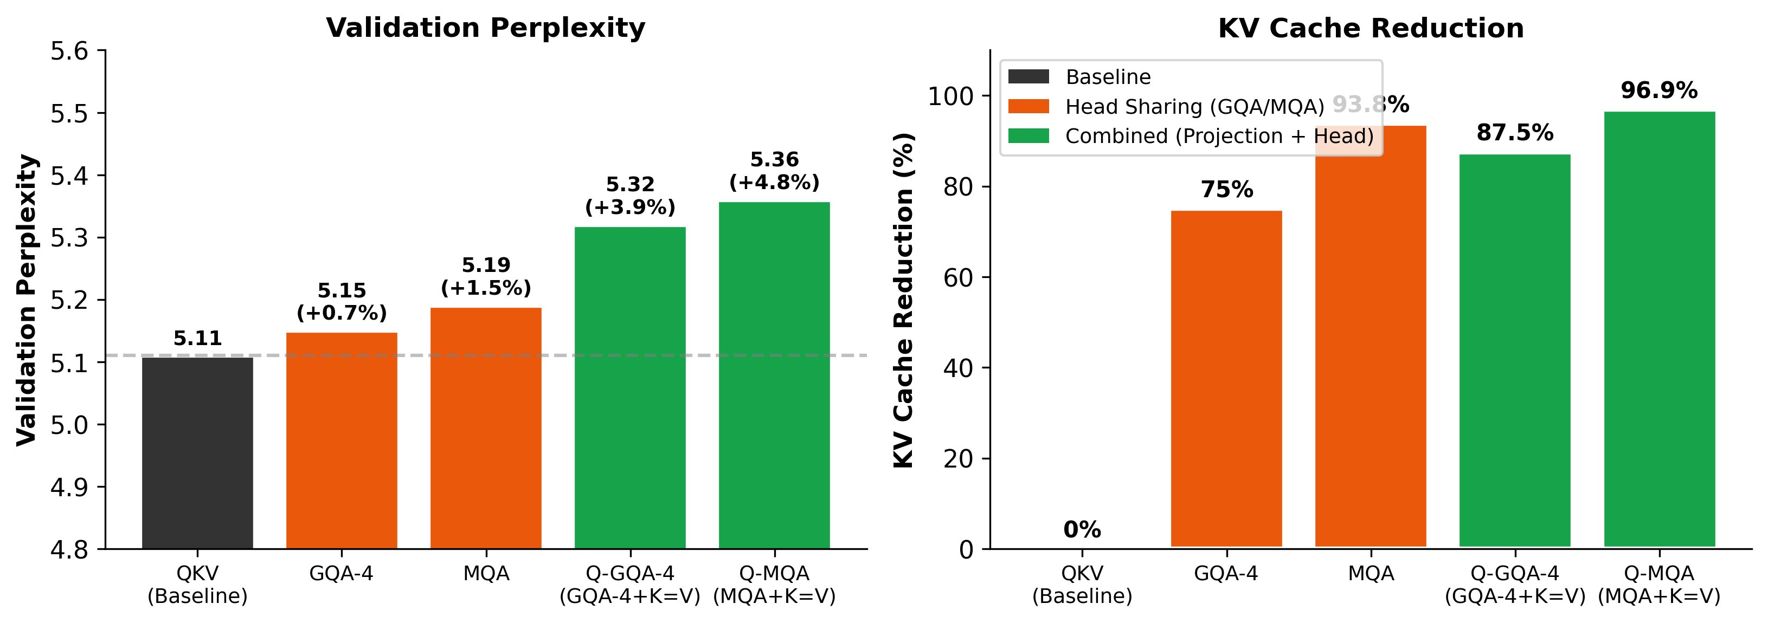
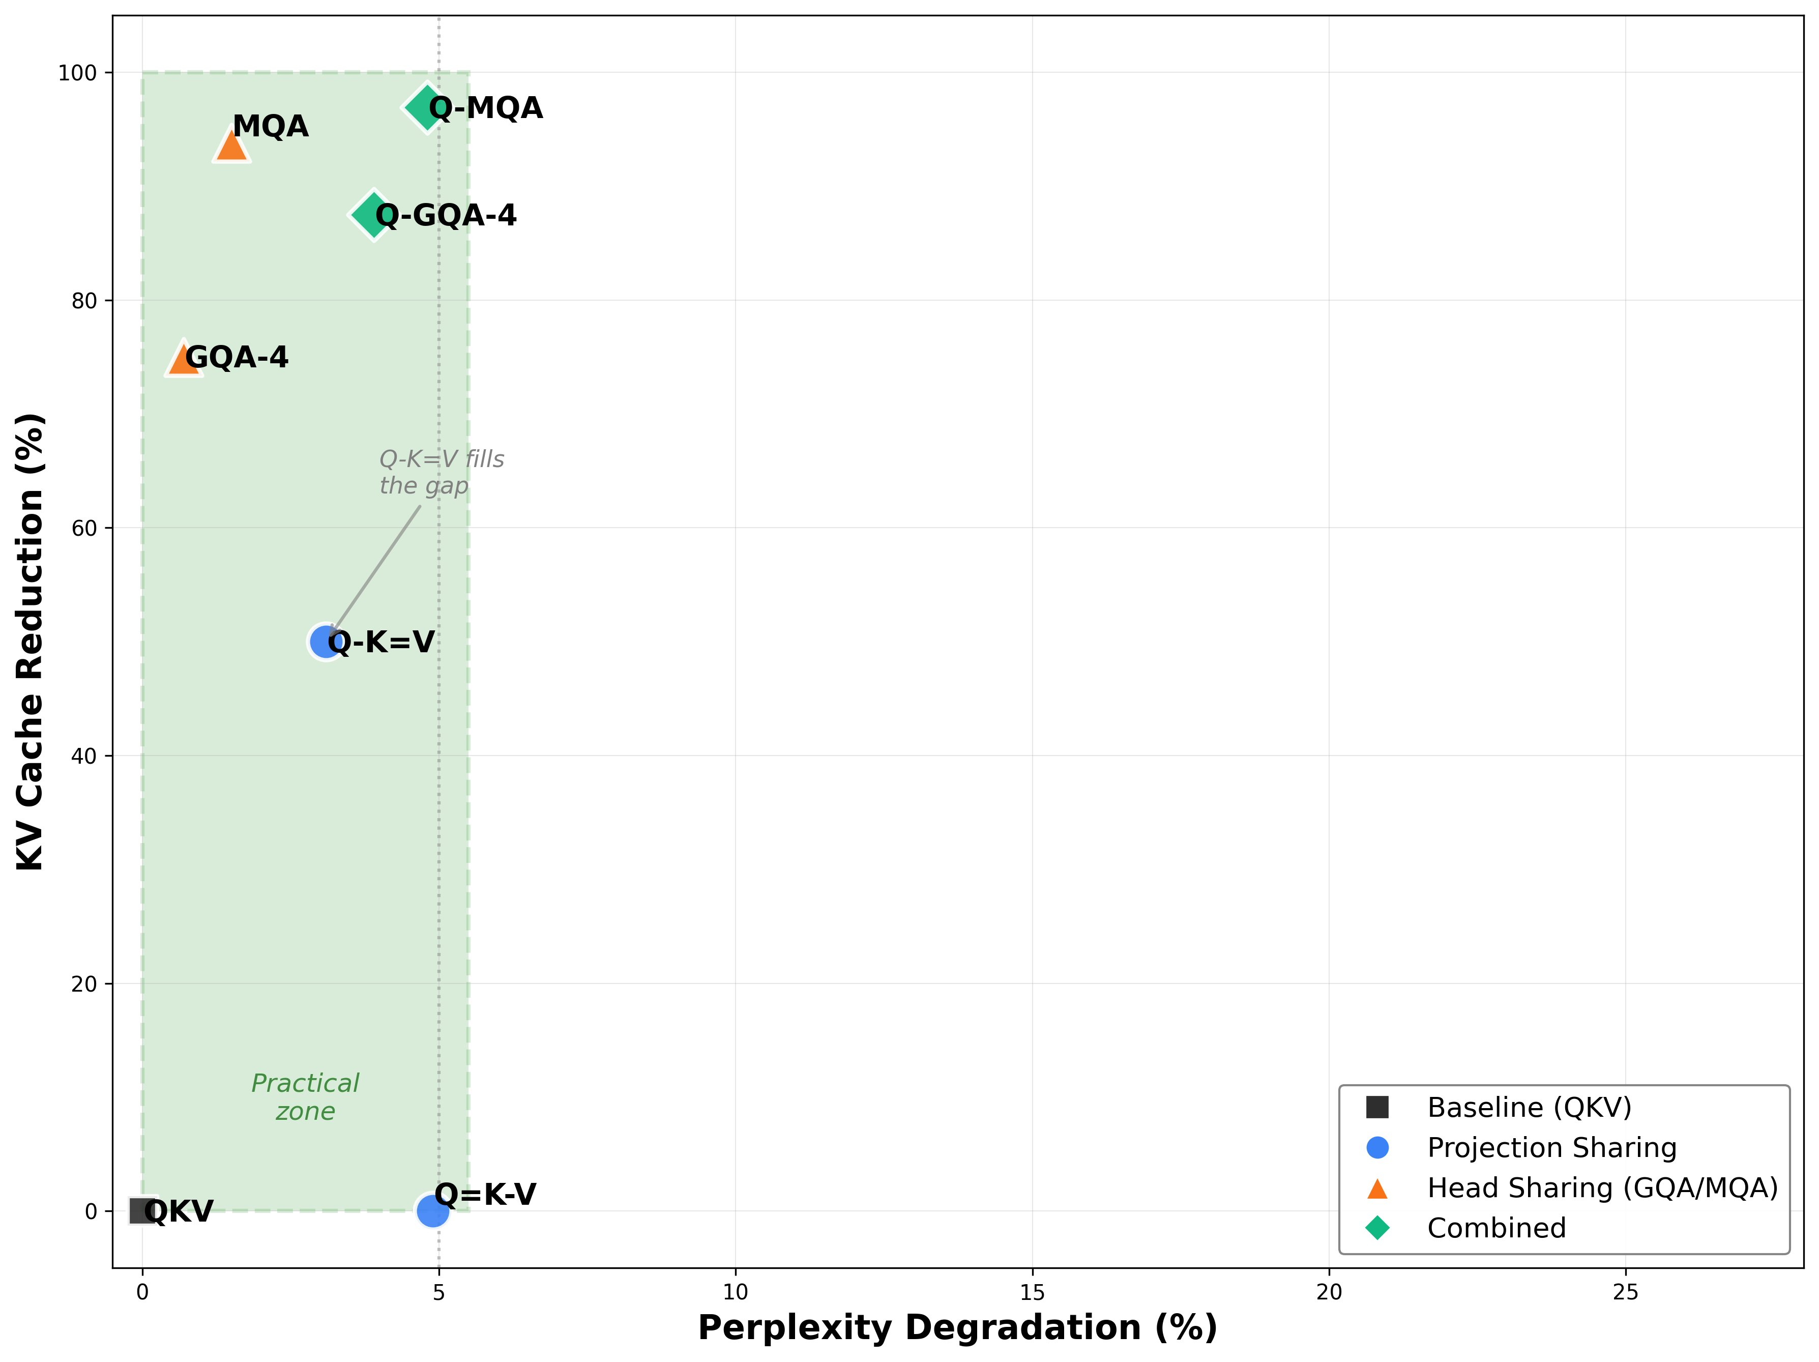
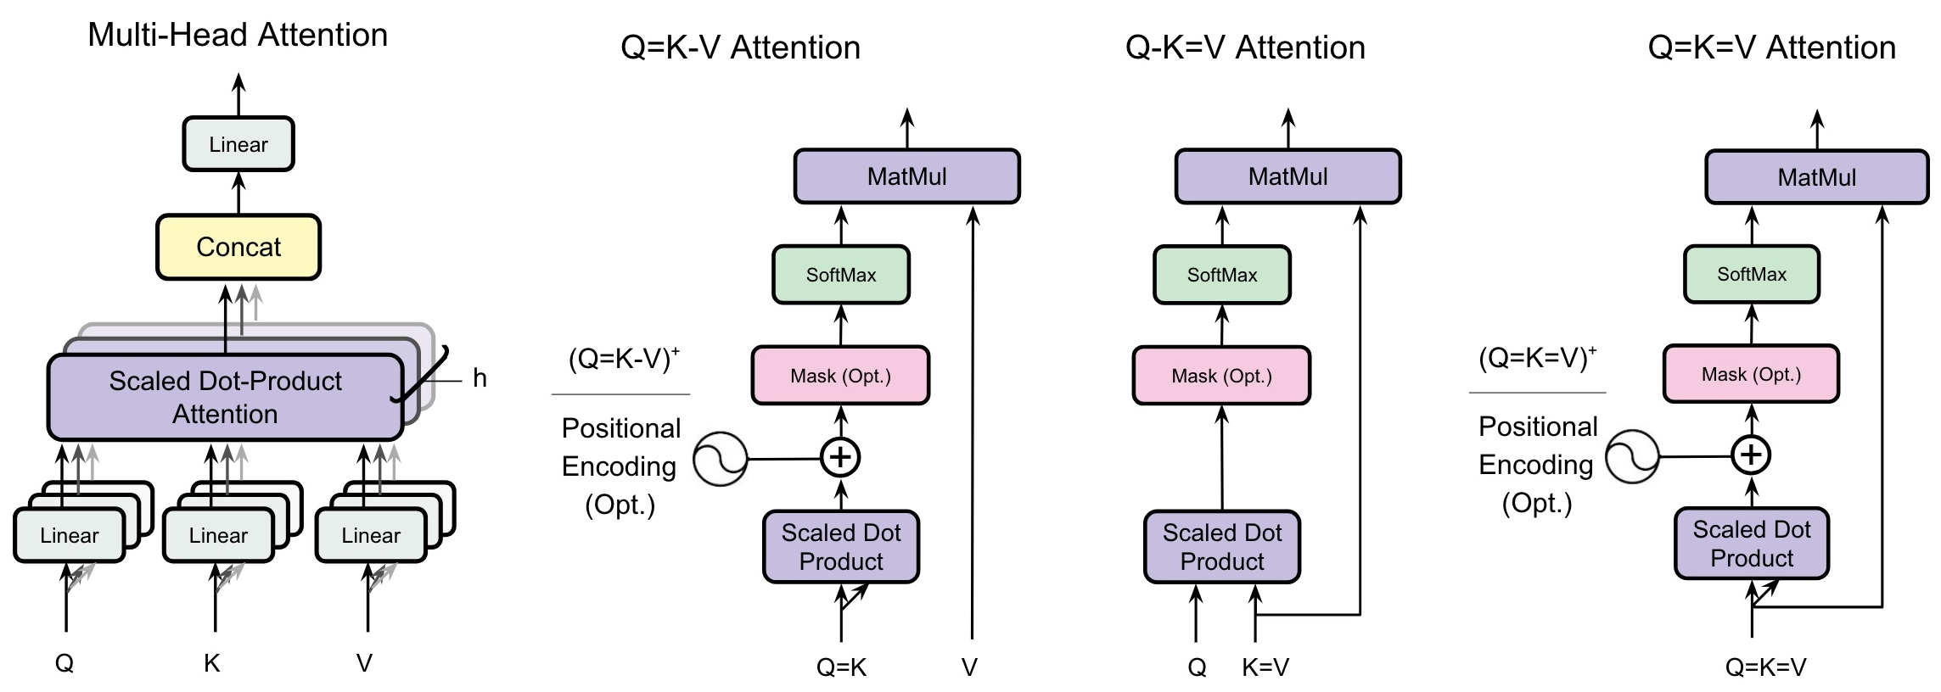






Do Transformers Need Three Projections: A Systematic Study of QKV Projection-Sharing Variants
Ali Kayyam • Anusha Madan Gopal • M Anthony Lewis
Problem Statement
Main Results: Language Modeling
Stacking with Head Sharing
Every attention head learns three separate linear projections of each token — Query, Key, Value. This redundancy is rarely questioned.
300M and 1.2B parameter models · 10B tokens · SlimPajama. Q-K=V is the clear winner among projection variants.
Projection sharing (K = V) is orthogonal to head sharing (GQA / MQA) — the two stack multiplicatively.
CNNs, RNNs and State-Space Models use unified internal representations — Transformers keep three. Is the tripartite design actually necessary?
THREE PROJECTION-SHARING CONSTRAINTS
Fig: Head sharing (orange) and combined projection+head sharing (green).
Q=K-V
Share Query & Key → symmetric maps
Fig: Validation perplexity (left) and KV cache reduction (right).
Q-K=V
Share Key & Value → our key result
+3.1%
50%
+25.4%
perplexity cost
cache reduction
Q=K=V collapses
Q=K=V
Single projection → most aggressive
Setup 20 layers · d = 1024 · 16 heads · AdamW · bf16 on 8×A100
Results (val perplexity) QKV 5.11 · Q-K=V 5.27 (+3.1%) · Q=K-V 5.36 (+4.9%, no cache benefit)
Method: projection Sharing
Why It Works?
Q-K=V preserves quality
Fig: Efficiency–quality Pareto frontier. Q-K=V fills the gap to head-sharing methods.
Keys & Values can share representational space while attention QKᵀ stays asymmetric. Trained QKV models confirm it: cos(K,V)=0.73 with similar rank, while Q stays distinct (cos(Q,K)=0.42).
Deployment & Impact
Q=K-V breaks directionality
Cloud — quality
GQA-4
75%
cache ↓
Forcing Q = K makes the attention map symmetric (KKᵀ), breaking the causal directionality language modeling needs: +4.9% perplexity with zero cache benefit. Q=K=V inherits both flaws.
Edge — balanced
50%
cache ↓
Fig: Attention variants — same core mechanism, only the tied projections change.
Q-K=V
Key Takeaways
Edge — aggressive
Q-GQA-4
87.5%
cache ↓
Projection cost drops 33%: QKV 3nd² → 2nd² → nd²
(X)⁺ variants add a fixed 2D positional encoding to restore directional asymmetry on non-causal tasks (vision, synthetic).
Key Takeaways
1
K = V is enough
IoT / Mobile
96.9%
cache ↓
50% KV-cache cut at only +3.1% (300M) / +2.48% (1.2B) perplexity.
Q-MQA
2
Asymmetry is what matters
Quality needs Q distinct from a shared K-V — not three projections.
3
Orthogonal to head sharing
Perplexity ≠ capability. At 1.2B, Q-K=V trails QKV by 2.48% perplexity but only 0.41% downstream accuracy — while halving the KV cache. Up to 67× cache reduction with Q-MQA enables practical billion-parameter edge inference.
Stacks with GQA/MQA for up to 96.9% cache reduction.
Conclusion: Transformers don't need three projections — tying K = V halves the KV cache at minimal quality cost and stacks with head sharing.
Code: github.com/anushamadan02/Do-Transformers-Need-3-Projections

